Slide 1

Data Science Using Python
Group C1

Slide 2
CONTENT
Mathematics
Data Acquisition
Numpy
Advanced Statistics
Linear Regression
Football statistics
Week 1
Week 2
Week 3
Week 4
Project
Distributions
Data Analysis
Visualization
Data science with Machine learning

Slide 3

Week 1
Mathematics, Data Acquisition & Numpy
1
Revision of basic Python
Installation of Anaconda
2
Basic Probability
Summary Statistics
Sampling & Linear Algebra
3
Acquisition of Data

Slide 4


Week 2
Distributions and Data Analysis
1
Data Visualizations
2
Dataset Provider
– Kaggle
3
Python Modules
– Pandas & Mathplotlib

Slide 5
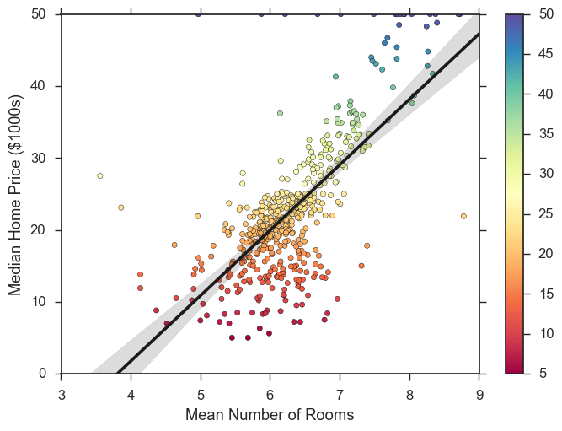
Week 3
Advanced Statistics
1
Confidence Intervals
2
Commonly used Distributions
3
Correlation and Linear Regression

Slide 6

Week 4
Data science with Machine learning
1
Overlap of fields
2
Introduction to Multiple Regression
Logistic Regression
3
Introduction to clustering
K-Nearest Neighbors
Gradient Descent

Slide 7




Project Advancement
Football Analysis
Acquisition of Data
Cleaning
Data Visualization
Analysis

Slide 8
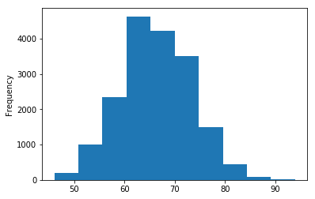
Project Analysis-Hist Plot
Football Analysis

Slide 9
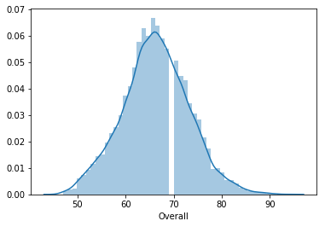
Project Analysis-Dist Plot
Football Analysis

Slide 10
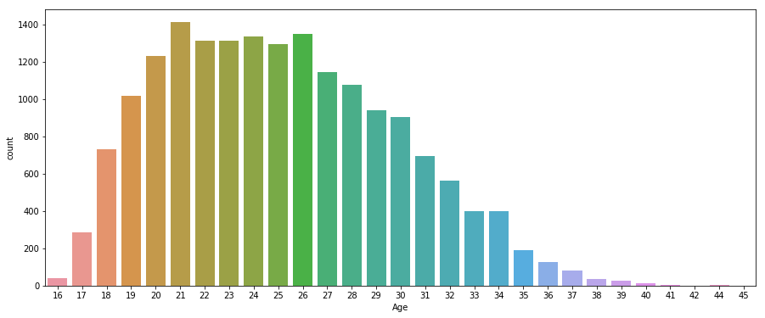
Project Analysis-Count Plot
Football Analysis

Slide 11
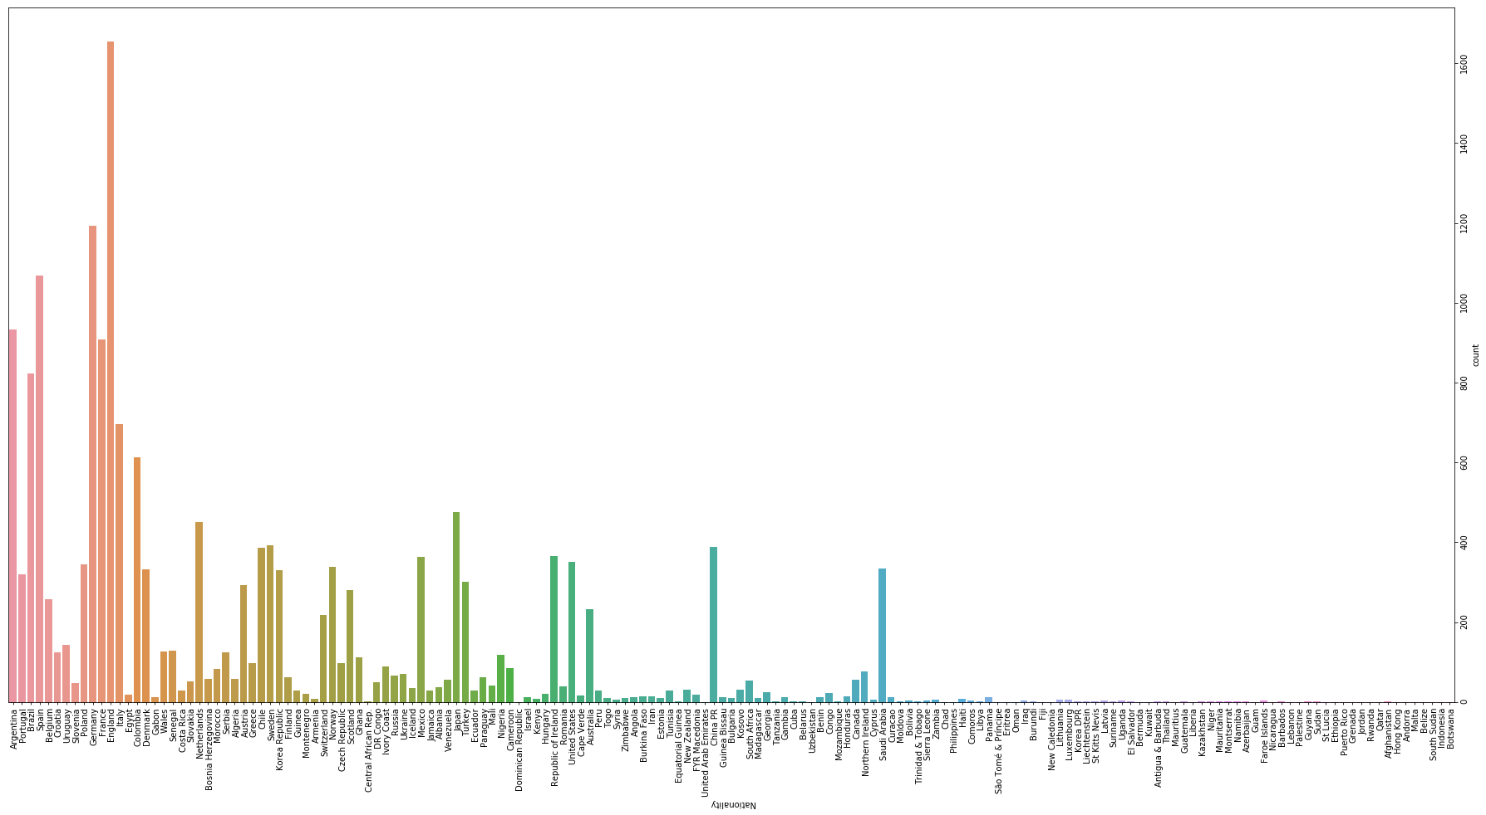
Project Analysis-Count Plot
Football Analysis

Slide 12
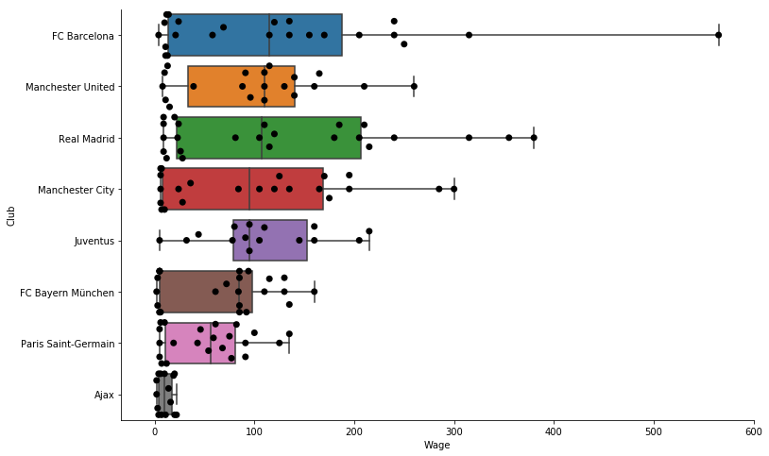
Project Analysis-Box Plot/Swarm Plot
Football Analysis

Slide 13
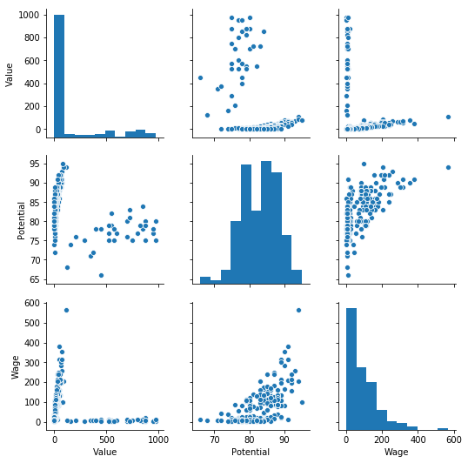
Project Analysis-Pair Plot
Football Analysis

Slide 14
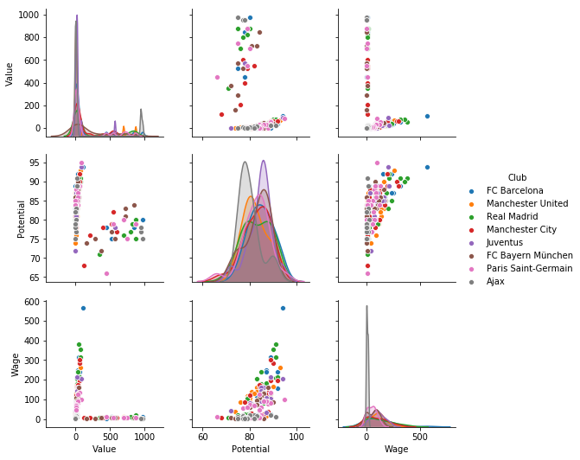
Project Analysis-Pair Plot
Football Analysis

Slide 15
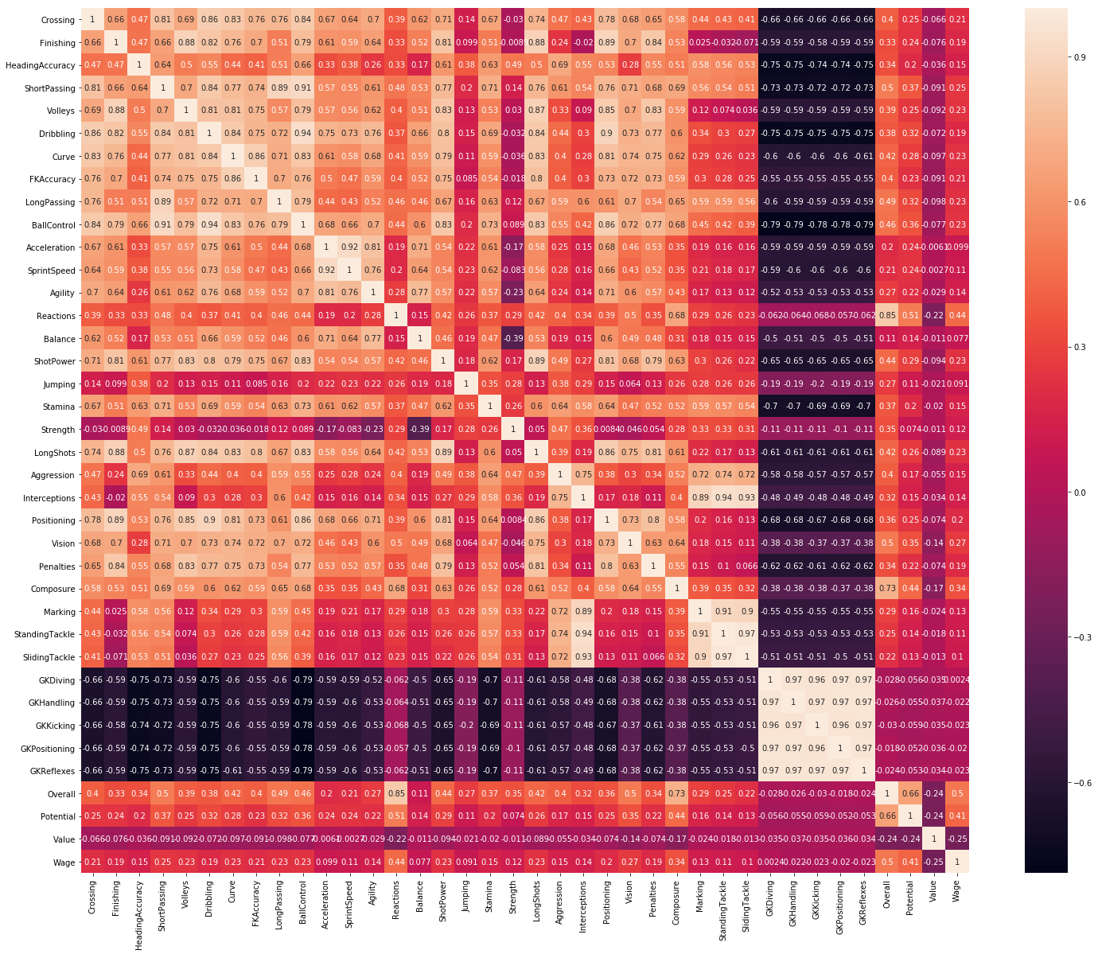
Project Analysis-Heat Map
Football Analysis

